Slide 1


VISVESVARAYA TECHNOLOGICAL UNIVERSITY BELAGAVI
FINAL PHASE PROJECT PRESENTATION
Presented by
ABHISHEKGOWDA DS 4BB21CS002
CHANDAN M H 4BB21CS009
CHANDRASHEKHAR D 4BB21CS015
DARSHAN S 4BB21CS016
Under the guidance of
Mr. Faiz Aman B.E., M. Tech.
Assistant Professor
DEPARTMENT OF COMPUTER SCIENCE AND ENGINEERING
BAHUBALI COLLEGE OF ENGINEERING
SHRAVANABELAGOLA – 573135
2024-2025

Slide 2
“INTRUDER DETECTION AND ALERTING SYSTEM WITH MACHINE LEARNING”

Slide 3
CONTENTS
ABSTRACT
INTRODUCTION
EXISTING SYSTEM
PROPOSED SYSTEM
SYSTEM DESIGN
ADVANTAGES OF PROPOSED SYSTEM
SYSTEM REQUIREMENTS
LITERATURE SURVEY
APPLICATIONS
REFERENCES

Slide 4
ABSTRACT
Utilizes machine learning and facial recognition to detect unauthorized individuals in real time.
Sends instant alerts to security personnel with visual evidence.
Provides a user-friendly interface for tagging individuals as “known” or “unknown”.
Scalable design allows for future upgrades like live streaming and predictive analytics.

Slide 5
INTRODUCTION
Automates intruder detection using machine learning to improve real-time surveillance.
Integrates facial recognition to identify unauthorized individuals and send alerts instantly.
Provides a classification system for tagging individuals as "known" or "unknown" with archived footage for future reference.
Designed for scalability, allowing additional features like predictive analytics and live streaming in high-security settings

Slide 6
EXISTING SYSTEM
Manual Surveillance: Traditional systems rely heavily on human monitoring, leading to missed incidents due to fatigue or oversight.
Limited Real-Time Analytics: Some systems offer basic real-time analytics like motion detection, but they struggle with accuracy in complex conditions (e.g., low lighting, crowded areas).
Isolated Alarm Systems: Alarm systems often function separately from surveillance, delaying responses as users need to verify alerts across different platforms.
Integration Issues: Existing systems lack seamless integration with other security tools, reducing overall monitoring efficiency and making comprehensive threat response challenging

Slide 7
PROPOSED SYSTEM
Real-time Threat Detection: Uses advanced machine learning algorithms, including facial recognition and behavioral analysis, to identify unauthorized individuals and suspicious activities instantly.
Automated Alerts: Upon detecting an intruder, the system triggers immediate alerts, including visual evidence sent via mobile apps, SMS, or email, ensuring rapid response.
Interactive Classification: Detected individuals are classified as “known” or “unknown,” with footage stored accordingly. Administrators can interact with the system to manage classifications directly.
Scalability and Integration: The system is designed to integrate seamlessly with existing infrastructure, allowing for easy expansion with additional cameras and sensors and providing future enhancements like live streaming and predictive analytics.

Slide 8
SYSTEM DESIGN
Data Collection: Capture data through cameras and sensors in real-time (video feeds, user behavior, etc.).Preprocessing: Clean and filter the collected data to remove noise and prepare it for analysis.
Feature Extraction: Extract relevant features, such as abnormal access patterns or suspicious movement, from the preprocessed data.
Model Training: Train machine learning models (e.g., facial recognition, behavioral analysis) using labeled datasets of normal and intrusive behavior.
Model Evaluation: Assess the accuracy of the trained models through validation, tuning, and cross-validation to ensure high performance.

Slide 9
SYSTEM DESIGN
Real-Time Detection: Apply the trained models to detect suspicious or unauthorized activities in real-time.
Intruder Detected: If an intrusion is identified, flag the event and trigger immediate actions.
Alert System: Generate and send alerts to security personnel via SMS, email, or mobile app with visual evidence for quick response.

Slide 10
ADVANTAGES OF PROPOSED SYSTEM
Enhanced Security: Real-time threat detection with advanced machine learning improves overall security and response times.
Automated Alerts: Immediate alerts with visual evidence sent to security personnel for swift action.
Reduced False Alarms: Accurate detection minimizes false positives and negatives, ensuring reliability.
Scalability: Easily scalable to add more cameras or sensors as needed without disrupting the system.
User-Friendly Interface: Centralized dashboard for easy monitoring and management of alerts.
Seamless Integration: Integrates with existing security infrastructure, enhancing current systems without major overhauls.

Slide 11
System requirements
HARDWARE REQUIREMENT
CPU: Intel Core i5, 2.4 GHz or higher
Memory: 8GB RAM
Disk: 256GB SSD or higher
Display: 15-inch colour display
SOFTWARE REQUIREMENT
Coding: Python
Operating System: Windows 10 or 11 / Linux (Ubuntu 18.04+)
Libraries: Pandas, NumPy, Scikit-Learn, TensorFlow, OpenCV
Database: SQLite or MySQL (for storing and managing logs)

Slide 12
LITERATURE SURVEY
Sl.No | PAPER NAME | AUTHOR | YEAR | MERITS | DMERITS
1. | Comprehensive Review of Machine Learning-Based Intrusion Detection Systems for IoT | Rajan S., Rao V | 2023 | An extensive review of machine learning-based IDS tailored for IoT networks, addressing the unique constraints of IoT environments like low processing power and varied device architectures. Machine learning models including k-NN, Decision Trees, Random Forests, CNNs, and LSTMs, are suitability for different IoT applications. | High false-positive rates remain a challenge in IoT-based IDS, and generalizing models across diverse IoT devices can be difficult.
2. | A Survey on Challenges and Techniques in Intruder Detection and Alert Systems | R. Kumar, V. Reddy | February 2023 | Multiple machine learning approaches like supervised, unsupervised, and reinforcement learning, addressing their strengths and limitations. Techniques like reinforcement learning that can adapt detection policies based on real-time feedback, improving detection accuracy over time. | Does not focus on specific intrusion detection models but provides general insights, which may limit its applicability for specific environments or attack vectors...

Slide 13
3. | Privacy-Preserving Intrusion Detection System for IoT Networks | A. Gupta, S. J. Lee | June 2022 | Hybrid approach combining encryption protocols and machine learning enhances privacy while ensuring robust intrusion detection. | The system experiences increased latency due to encrypted data, which can hinder real-time detection, especially in large-scale IoT networks.
4. | Intrusion Detection with Homomorphic Encryption and Machine Learning | Ahmed N., Youssef M. | March 2022 | The detection of malicious patterns without compromising the confidentiality of sensitive data, which is critical for sectors like healthcare, finance, and government. | Decision Tree model is less accurate compared to Random Forest, though it offers better efficiency for real-time applications.
5. | Real-Time Intruder Detection in Surveillance Systems Using Computer Vision | L. Smith, K. Wong | 2021 | Integrates computer vision techniques, particularly Convolutional Neural Networks (CNNs) for facial recognition, into traditional surveillance systems to enhance detection accuracy. | The accuracy of the system can still be reduced in dynamic real-world environments, such as areas with varying lighting conditions or obstructions, leading to higher false negatives.

Slide 14
Home Security: Use the system to monitor residential properties, detecting unauthorized intrusions and sending immediate alerts to homeowners or security companies.
Business and Commercial Security: The system can be integrated with cameras and sensors to enhance real-time monitoring.
Smart Cities: Deploy the system in public spaces like parks, parking lots, and streets to enhance surveillance, reduce crime, and improve emergency response times.
Industrial Facilities: In manufacturing plants or power plants, the system can monitor sensitive areas and equipment, preventing unauthorized personnel from gaining access to dangerous zones.
Critical Infrastructure Protection: the system in power grids, water treatment plants, or government buildings to detect intrusions and protect national security.
Campus Security: Use it in schools or universities to protect campus buildings and dormitories from intruders, ensuring a safer environment for students and faculty.
APPLICATIONS

Slide 15
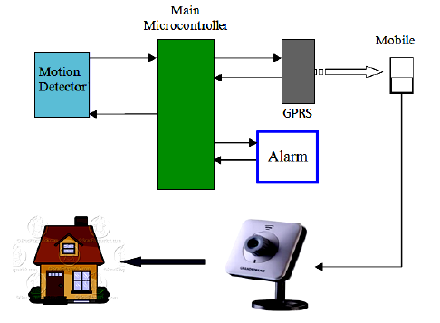
System design
sensors to detect movement or intrusion, a control unit to process sensor data and trigger alerts, a communication network to send alerts, and a power supply.

Slide 16
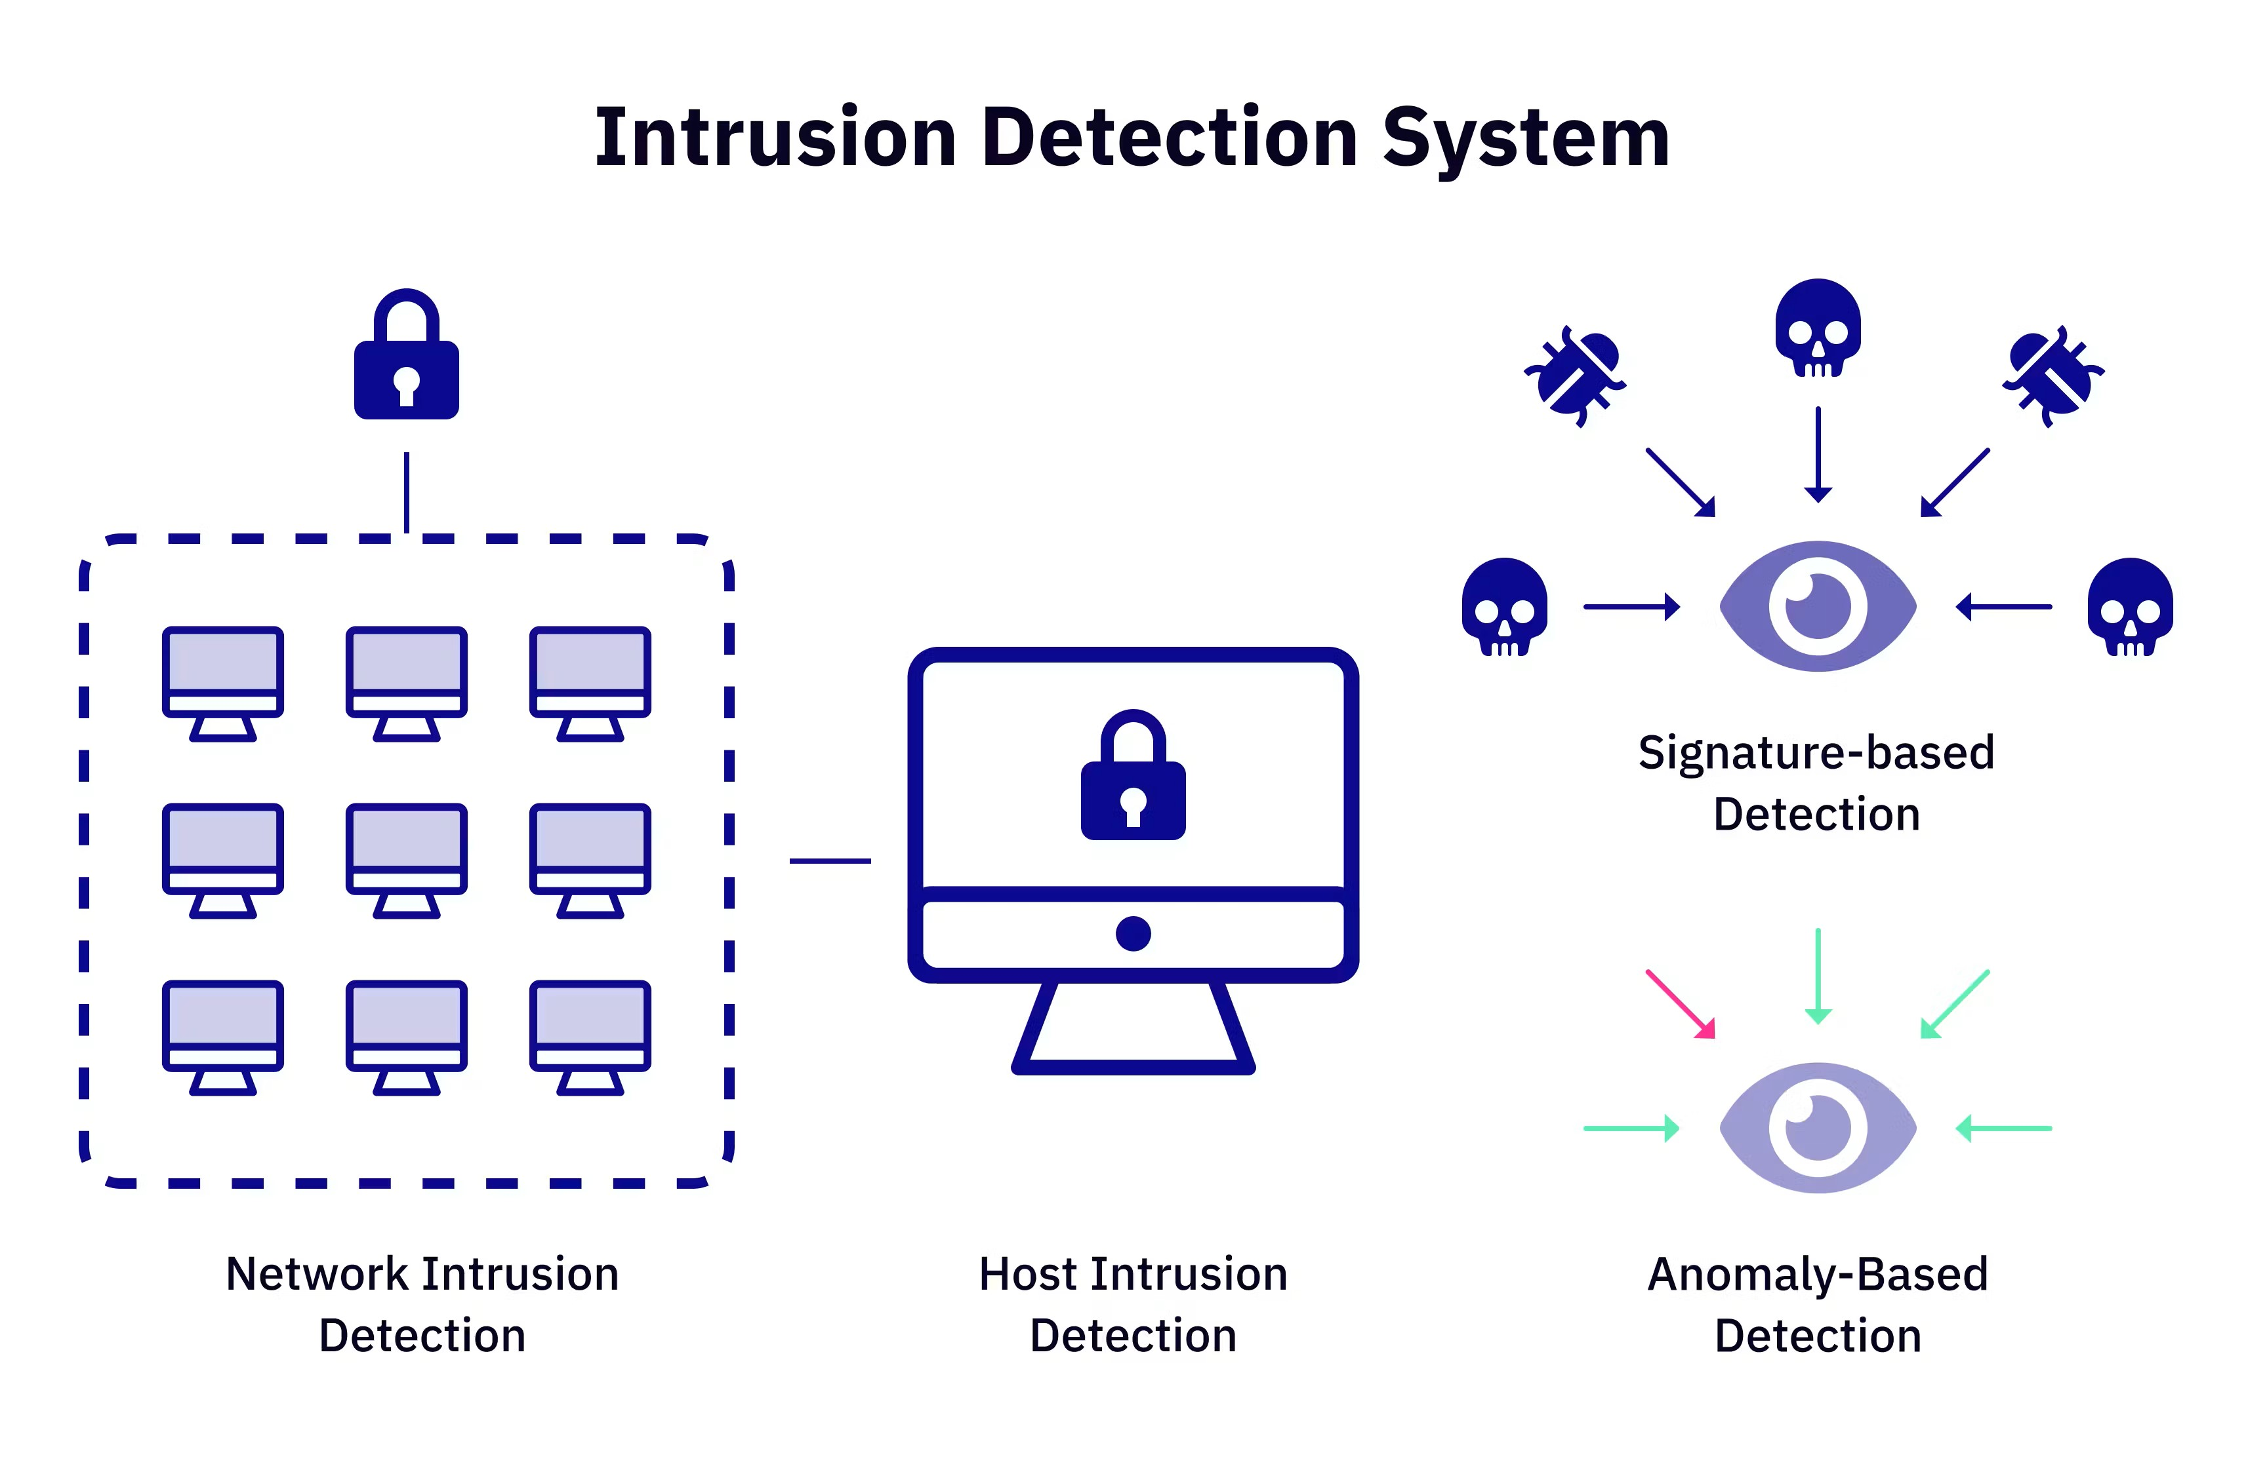

Slide 17
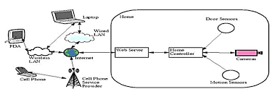
Implementation
An Intruder Detection and Alerting System can be implemented using sensors, a microcontroller, and a communication module to detect unauthorized entry and notify the owner. The system typically involves detecting movement or changes in the environment using sensors like PIR or LDR, triggering an alarm, and sending alerts (SMS, email, or mobile app notifications) to the owne

Slide 18
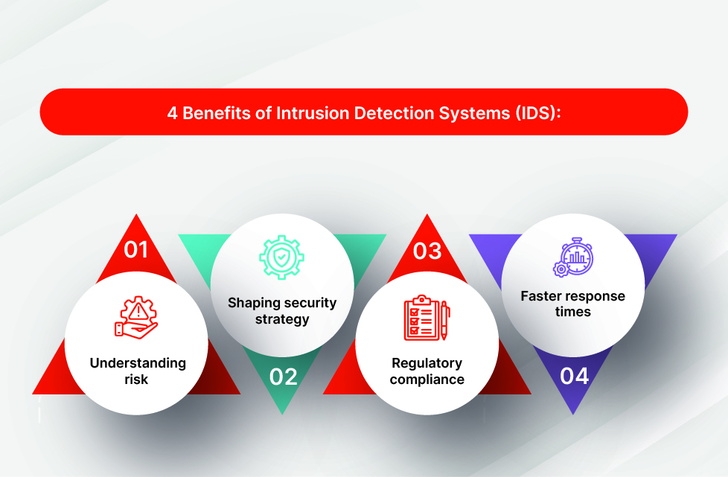
Conclusion
In conclusion, the Intruder Detection and Alerting System using Machine Learning offers an efficient and intelligent solution for enhancing security and surveillance. By leveraging advanced computer vision techniques and trained models, the system can accurately detect unauthorized individuals in real-time and immediately trigger alerts. This proactive approach not only minimizes the risk of theft or intrusion but also ensures a quick response by notifying the concerned individuals through automated channels such as Telegram bots or email.

Slide 19
THANK YOU…

